Slide 1
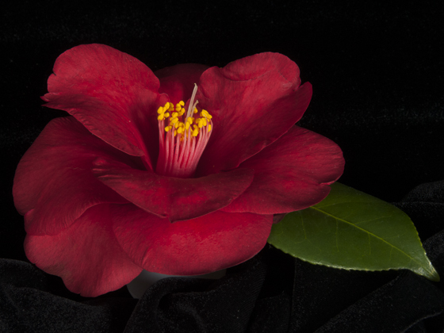
Our Beautiful Years

Slide 2
Early Tidewater Camellia Club History
Responding to an invitation from members of the Hanover Garden Club, a group of 17 men assembled September 25, 1952 to organize a garden club for men. Mrs. Russell Wood and Mrs. J.H. Farrell represented the Hanover Garden Club. Mr. Henry Rehder, who was instrumental in arranging the meeting, served as the first president and is considered Tidewater Camellia Club’s founder.
Two committees were formed by mutual consent:
CONSTITUTION: NOMINATION:
Harry Solomon (Chairman) Dr. William Doaher (Chairman)
Henry Rehder Arnold Petterson
Dr. William Walden J. Russell Wood
C.J. Oldenbuttel
The following officers were elected on September 30, 1952:
President: Henry Rehder
Vice President: C.J. Oldenbuttel
Secretary & Treasurer: W. H. Powell

Slide 3
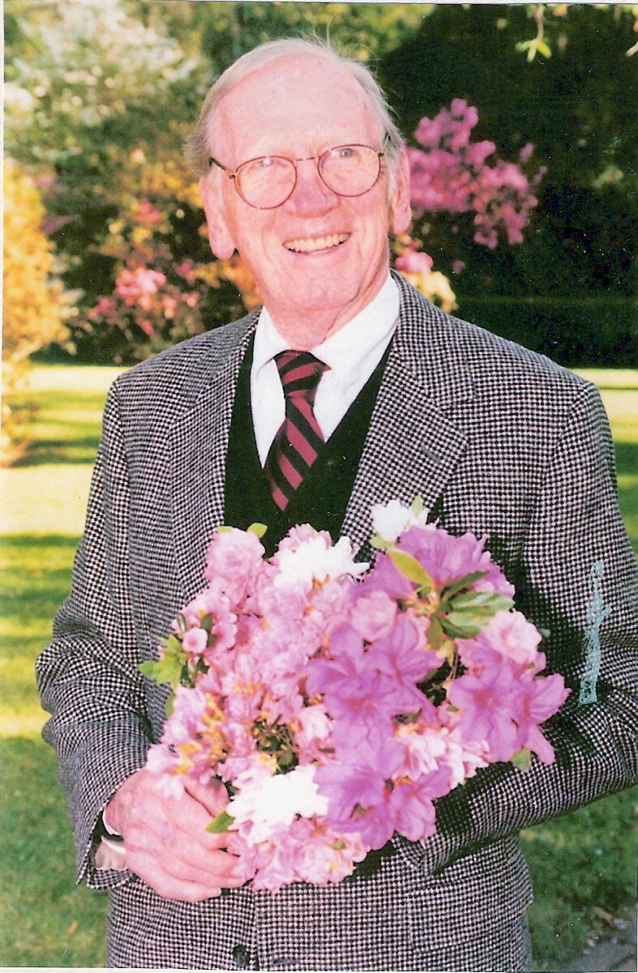
Tidewater Camellia Club was founded in 1952, Its first President was Wilmington’s Henry Rehder 1953.

Slide 4
Early Tidewater Camellia Club History
By 1958, club membership had grown to over 100. In 1960 the club’s name was changed to the Tidewater Camellia Club. The Club has sponsored a Camellia Show every year since 1956 except when cancelled due to freeze. Each year the Tidewater Annual Camellia Show has grown with exhibitors and judges from many southeaster states. Today it is one of the largest and best attended shows in the United States.
Tidewater Camellia Club leadership has been a major strength of the organization. Beginning with Henry Rehder in 1952, Club leaders have been active locally and nationally within the American Camellia Society. Tidewater Camellia Club has had three members elected to the Presidency of the American Camellia Society.
Our Honored ACS Presidents are:
S. Leslie Marbury…1956
Carl M. Allen…1993 - 1995
T. Edward Powers…1999 - 2001
Matt Hunter…2010 - 2013

Slide 5
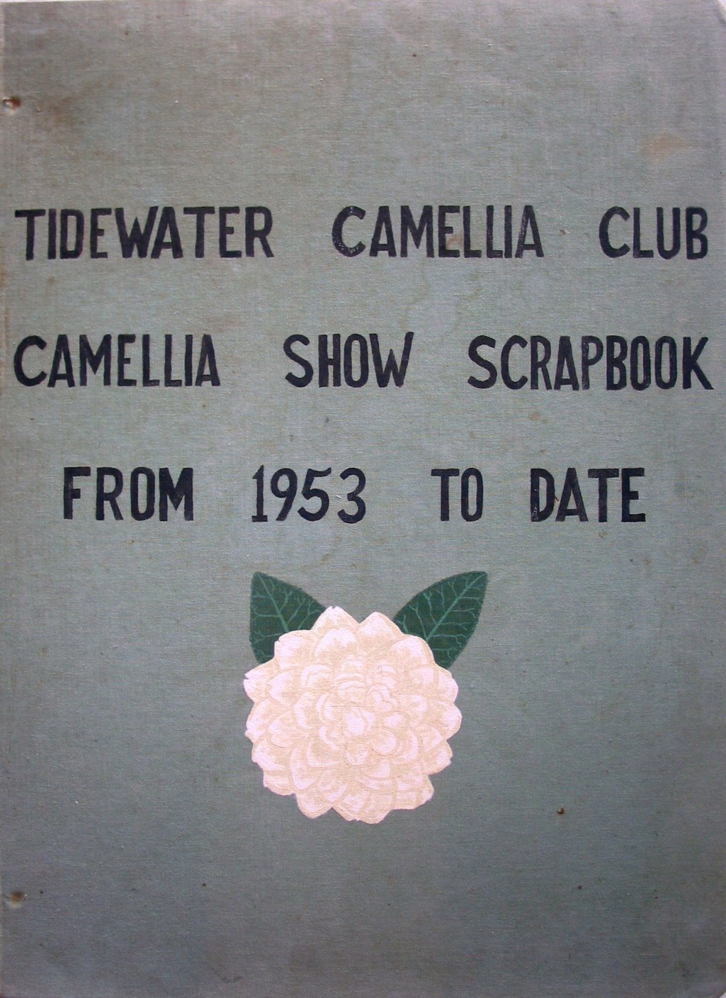
Book Cover Artist John Clayton, Jr. 1968
Source material for this presentation was obtained from Tidewater Camellia Club Show Scrapbooks 1953 to DATE and member photographs

Slide 6
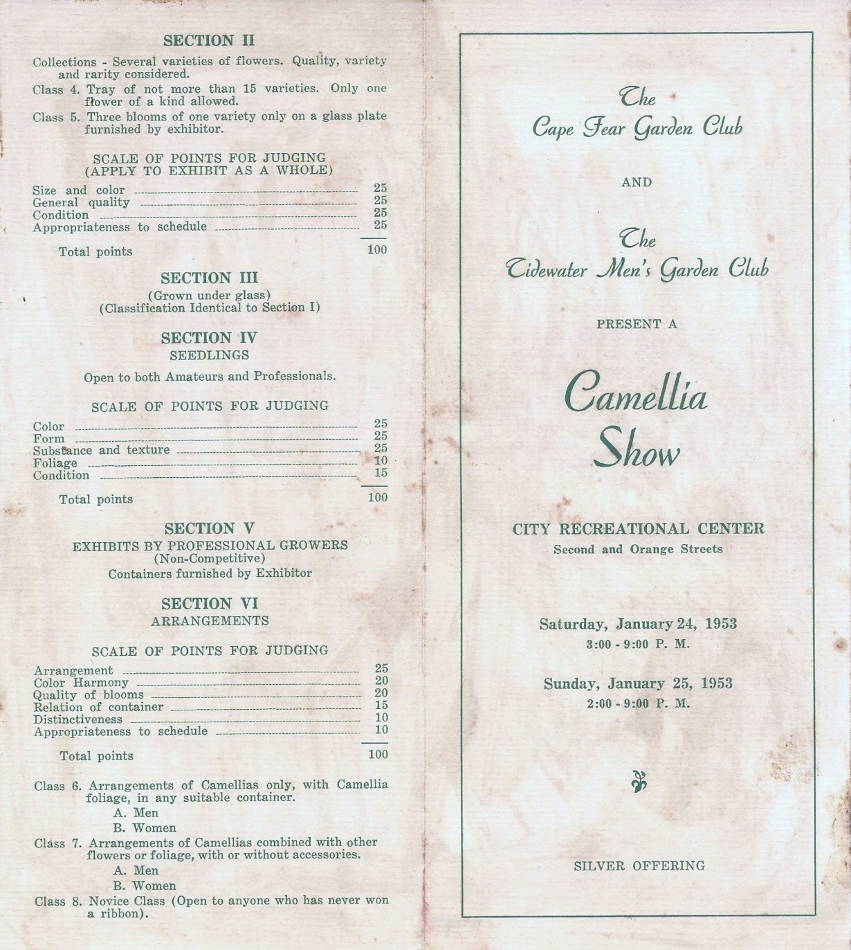
Tidewater Men’s Garden Club January 23 & 24, 1953 First Camellia Show Cosponsored with the Cape Fear Garden Club at City Recreational Center located at Second and Dock Street

Slide 7
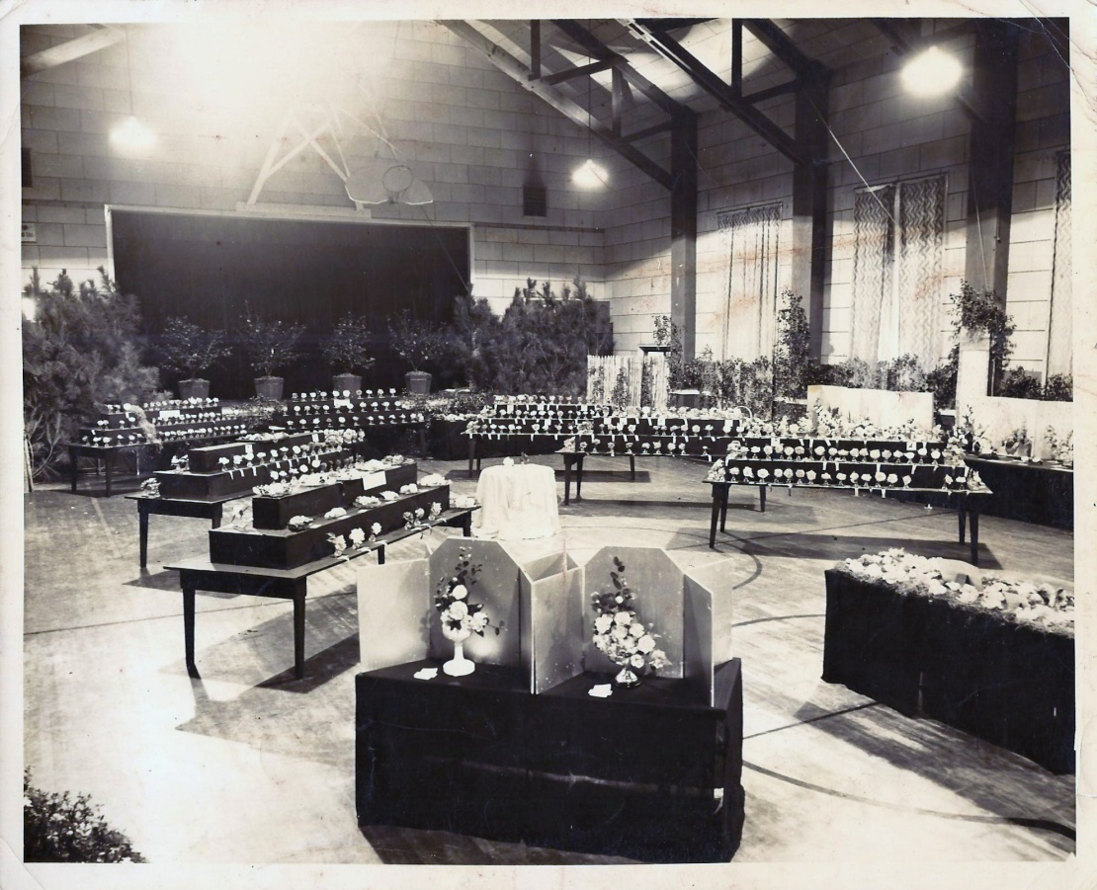
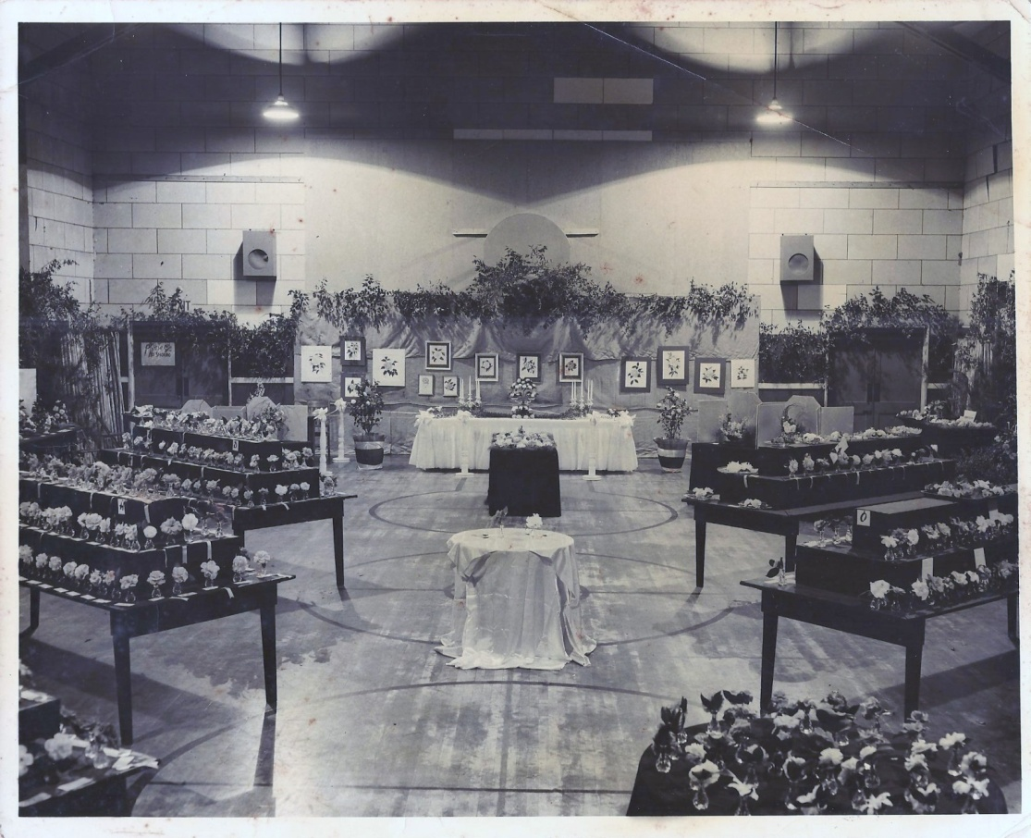
1954 Camellia Show
The show was cosponsored with the Cape Fear Garden Club in the newly named Community Center at Second and Dock Street. There were 100 exhibitors and 2200 blooms on display, all in GLASS CUPS. Camellia floral arrangements and camellia art were also important show displays

Slide 8
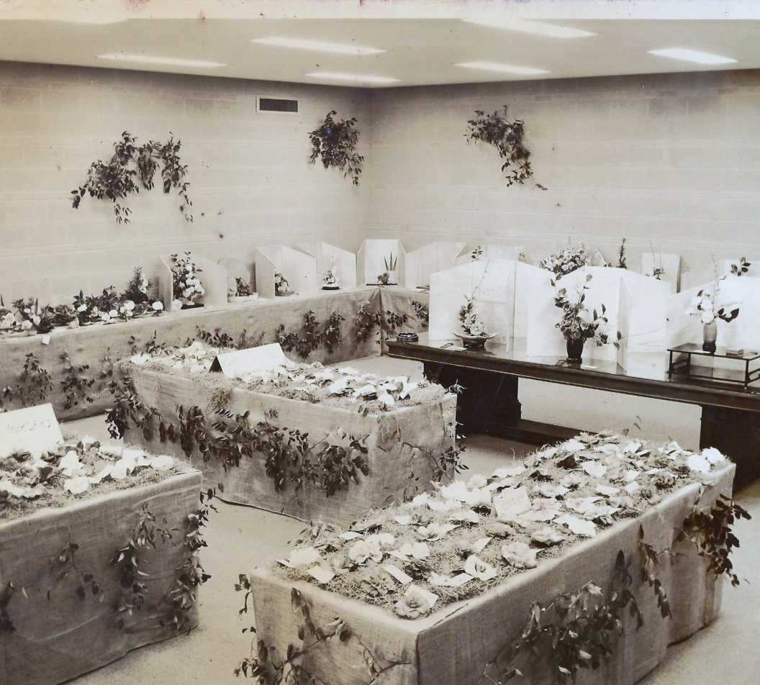
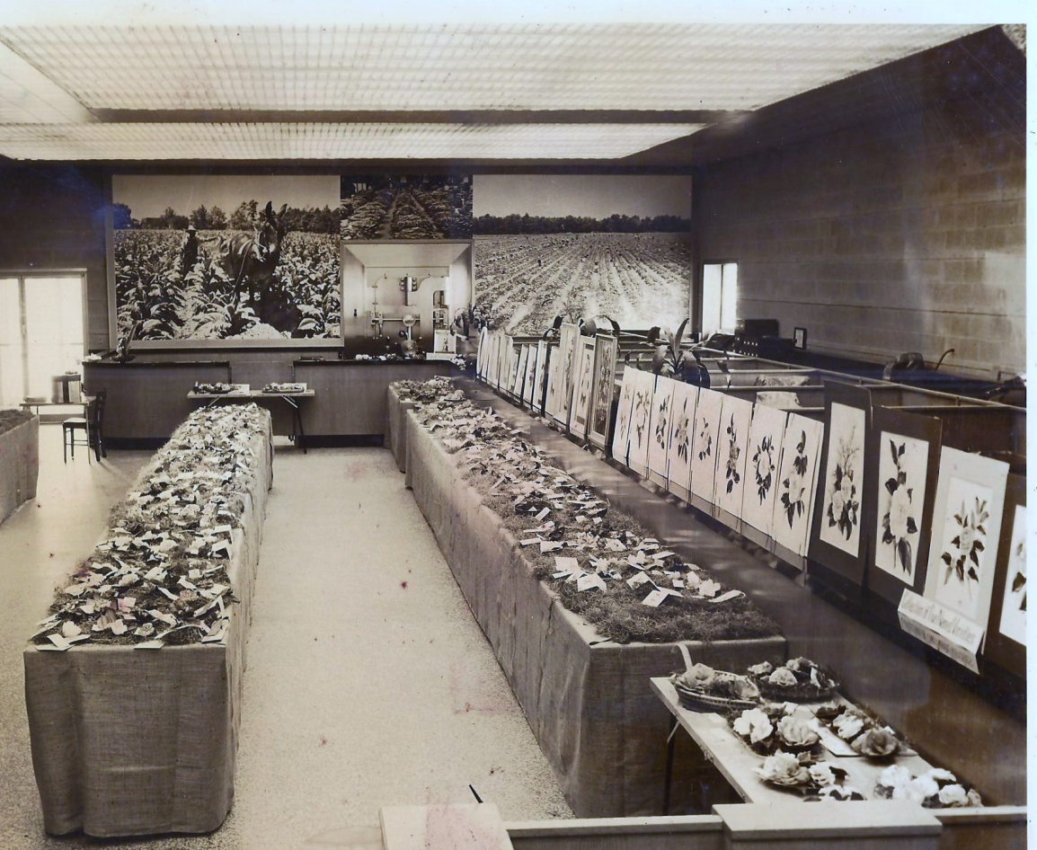
1956 Camellia Show
The 1955 & 1956 shows were held at the Wilmington Savings & Loan. Les Marbury + Carl Allen worked for Worthheimer Bag Co. and provided burlap coverings for the show. Blooms were displayed on spanish moss. The show also highlighted CAMELLIA ART and TRAYS OF THREE OR FIVE in baskets.

Slide 9
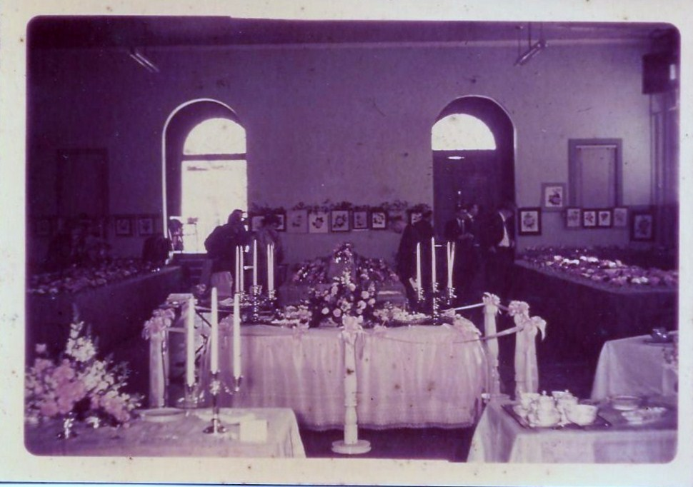
1957 Camellia Show
The 1957 show was held at Isaac Bear Gym in the old Wilmington College at Thirteenth and Market Street across from New Hanover High School.

Slide 10
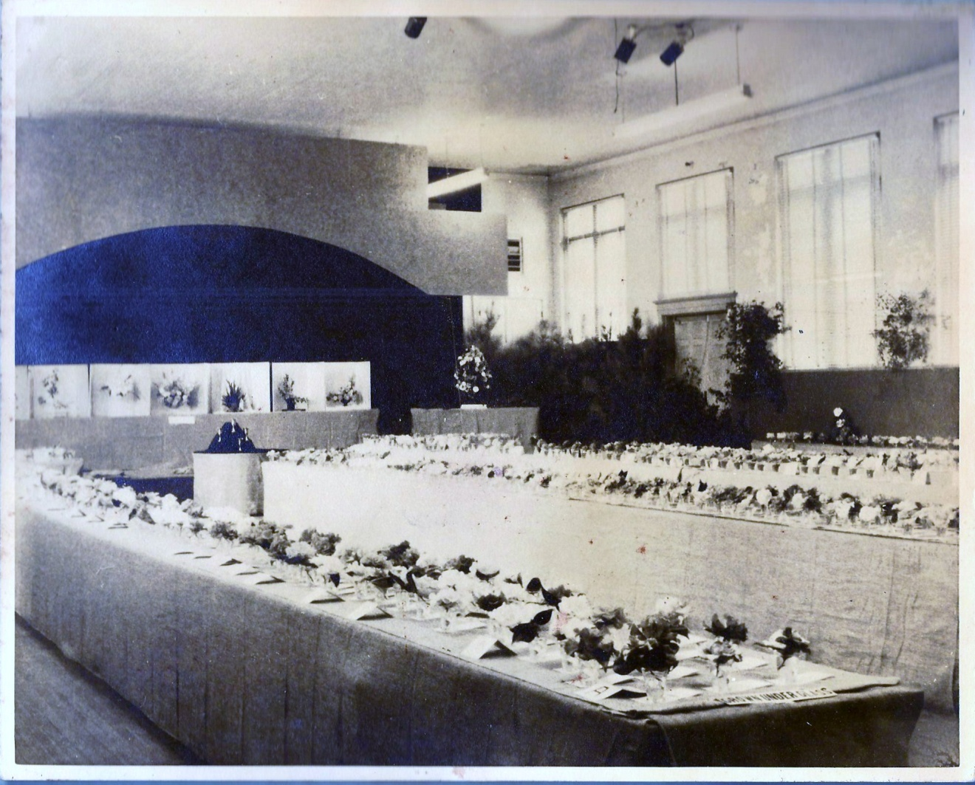
1960 Camellia Show
The 1959 & 1960 shows were also held at Isaac Bear Gym. In 1960 the club’s name became the Tidewater Camellia Club. Members were still men only. In 1961 the showed moved back to the Community Center.

Slide 11
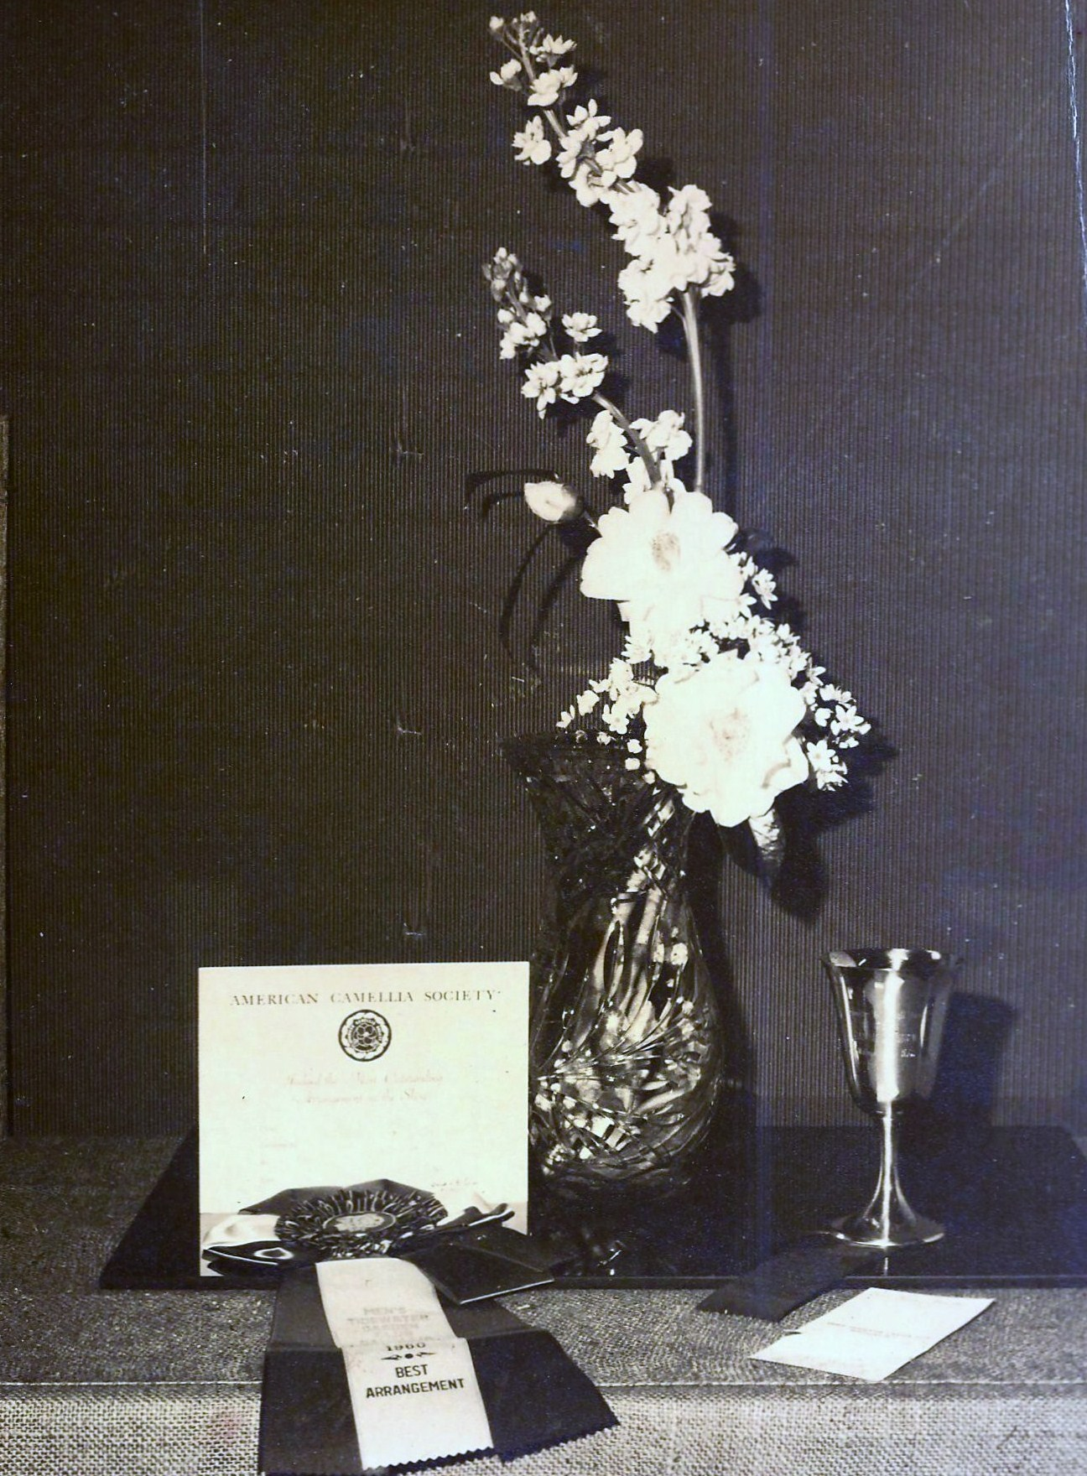
Floral Arrangements
Flower arrangements with a THEME were judged at shows. The arrangements were exhibited by women’s clubs and they had to use camellias.
The Theme from 1957 was Yesterday, Today and Tomorrow.
The 5 arrangement classes were Entrance Hall, Living Room, The Den and Moonlight Patio.
The Junior Division classes were Girl’s Dressing Table, Coffee Table and Sweet Old Fashioned Girl.
Commercial nurseries exhibited their plants but could not enter into classes.

Slide 12
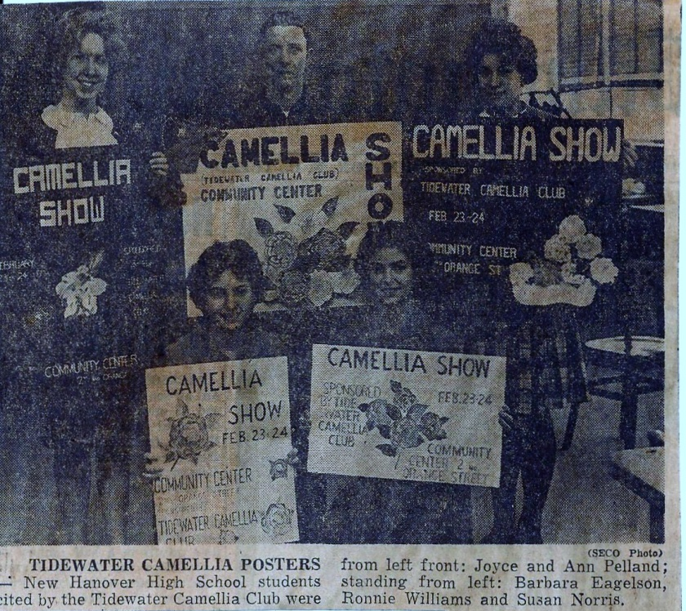
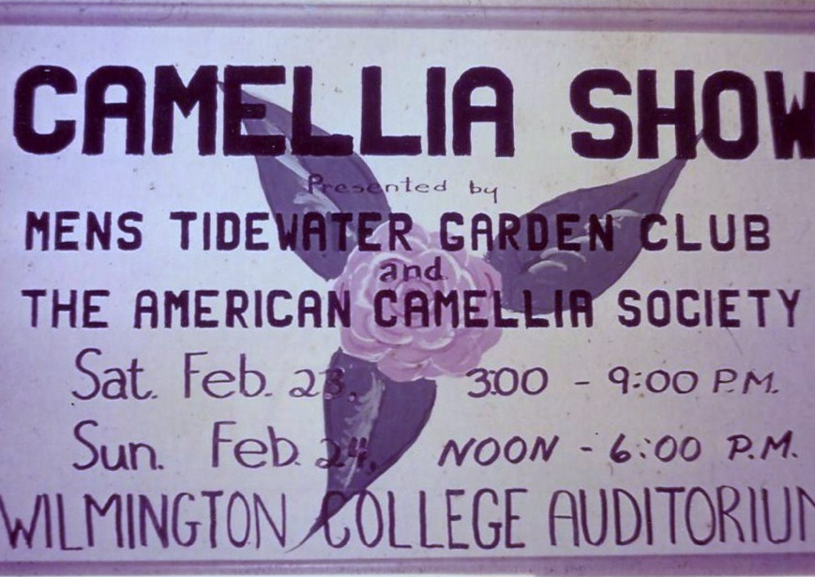
1963 Camellia Poster
The 1962 show was held on the fourth floor of the Wachovia Bank at Second and Princess Street. No pictures are available for this show.
In 1963, the New Hanover High School Art Department agreed to have their students make posters for the show. The First place winner receive $10. Posters were made for several years and placed with business merchants to advertise the show.
Unfortunately, the 1963 show was cancelled due to bad weather.

Slide 13
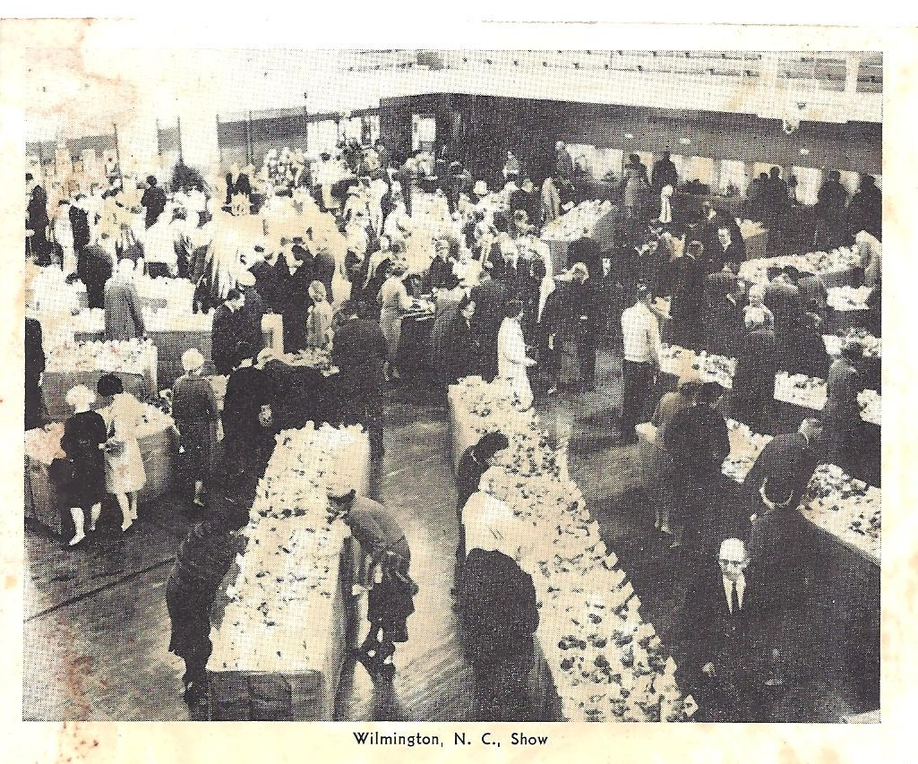
1964 Camellia Show
The 1964 & 1965 shows were held in the girl’s gym at New Hanover High School. The North Carolina Camellia Society met at the Cape Fear Country Club in conjunction with the show. In 1964, 3500 blooms were on display.

Slide 14
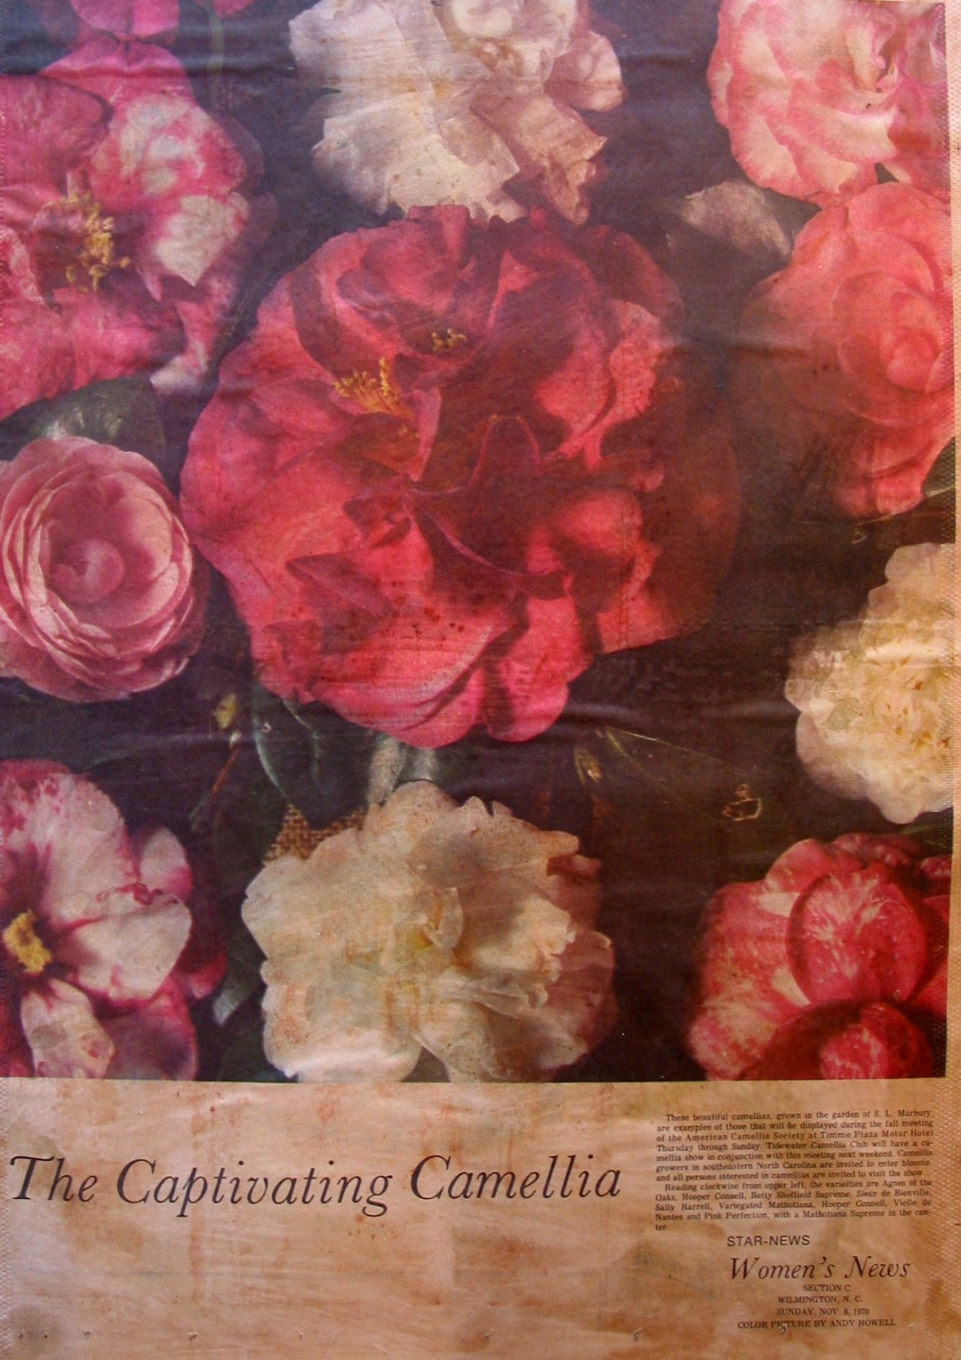
Show Publicity
The Publicity Chairman managed all TV, radio, newspaper and posters for the show.
Radio Stations and newspapers within 150 miles of Wilmington publicized the shows.
Leslie Gruber (Farm Editor), Bugs Berringer (garden specialist in Rocky Mount), and the Star News wrote articles on the show.
Local TV stations had camera crews attend the shows to be shown on Saturday night.

Slide 15
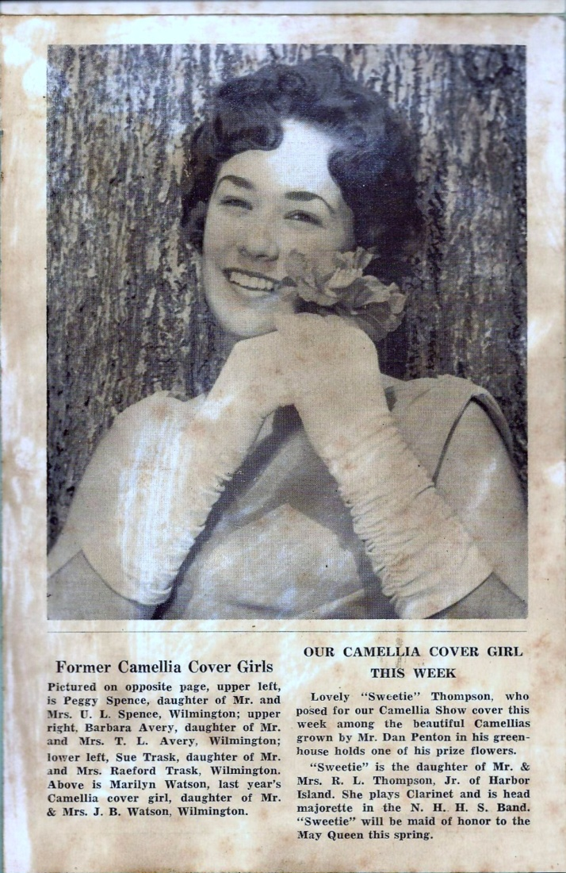
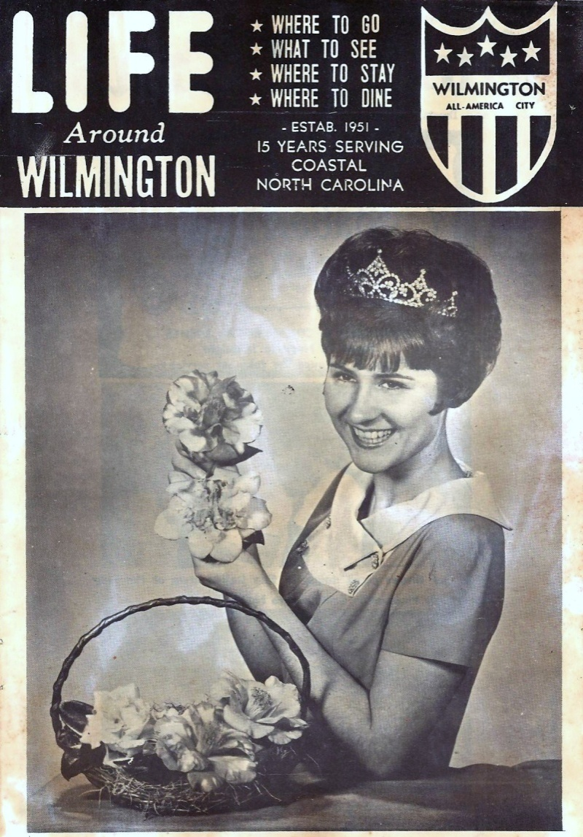
Camellia Cover Girls
Camellia Cover Girls were a traditional advertising feature for the shows.
Pictured is 1965 Camellia Show Cover Girl, “Sweetie” Thompson
and 1968 Miss Wilmington Jeanne Harden.

Slide 16
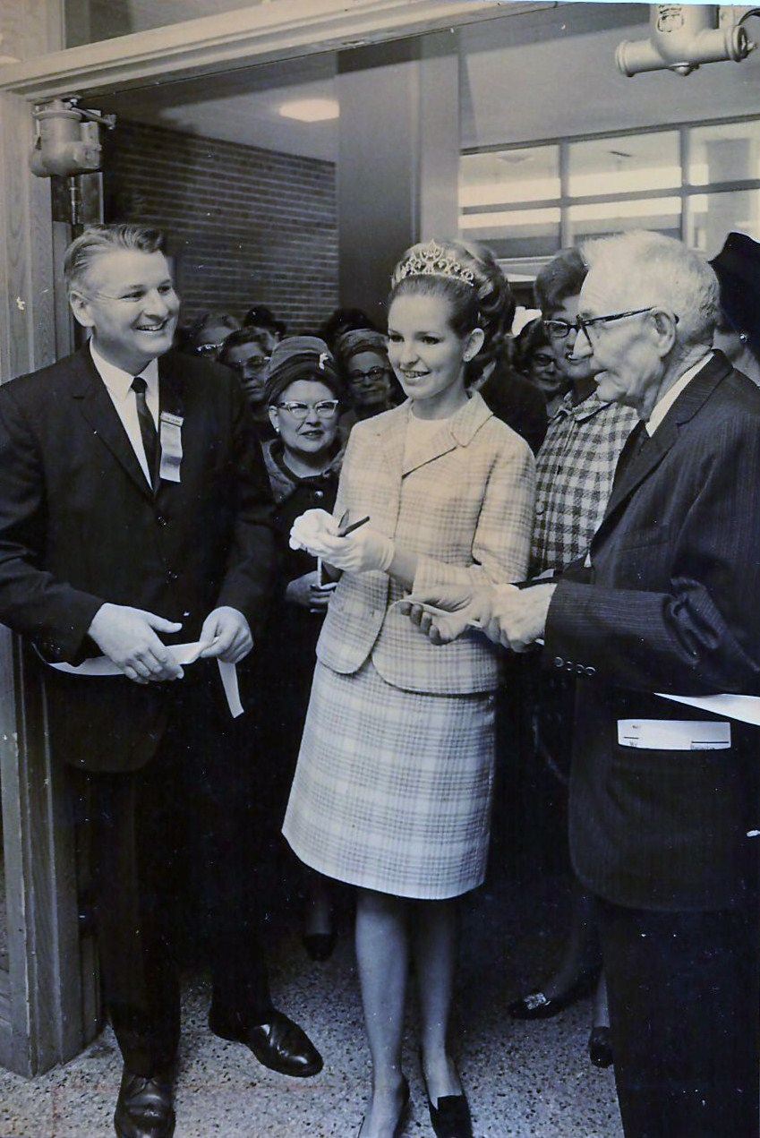
Ribbon Cutters
Traditionally, the currently crowned Miss Wilmington would serve as the Camellia Ribbon Cutter to open the show.
Wilmington’s Mayor and the Show Chairman would join in the ceremony.
Pictured Left to Right:
Bill Howell, Show Chairman
1969 Miss Wilmington Frances Farmer
Major Ogden Allsbrook

Slide 17
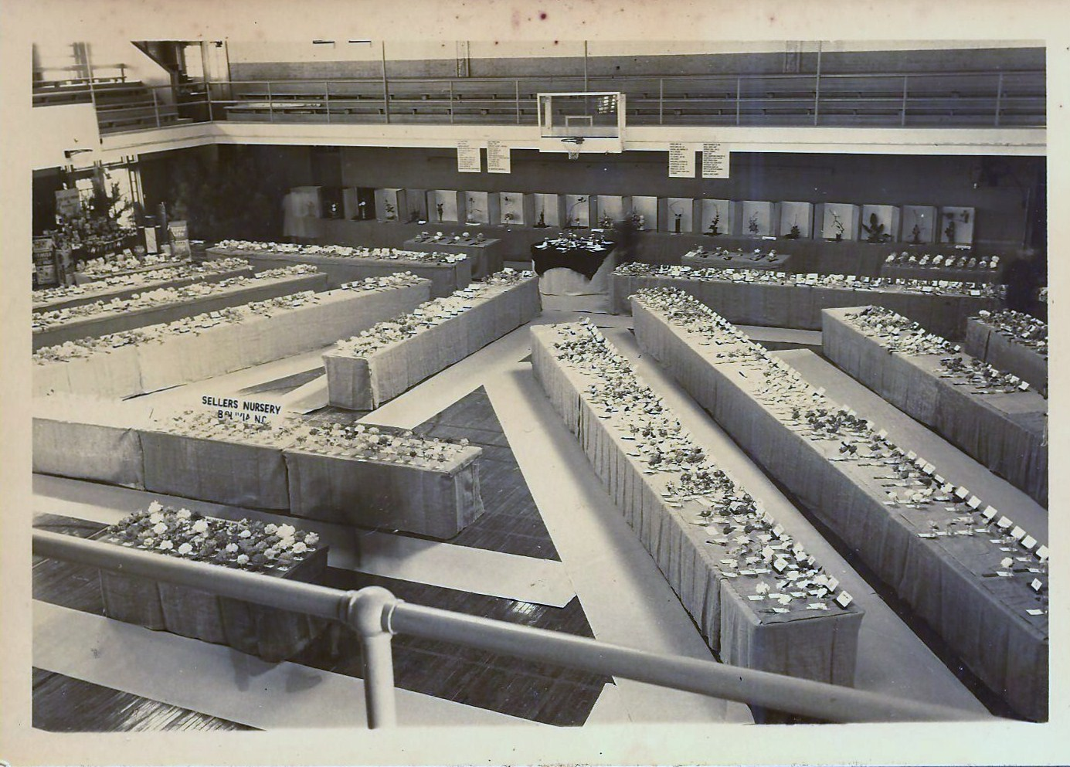
1966 Camellia Show
The 1966 & 1967 shows were again held at the girl’s gym in New Hanover High School. The shows were sponsored by 50 business merchants. 2500 Blooms were exhibited in 1966.

Slide 18
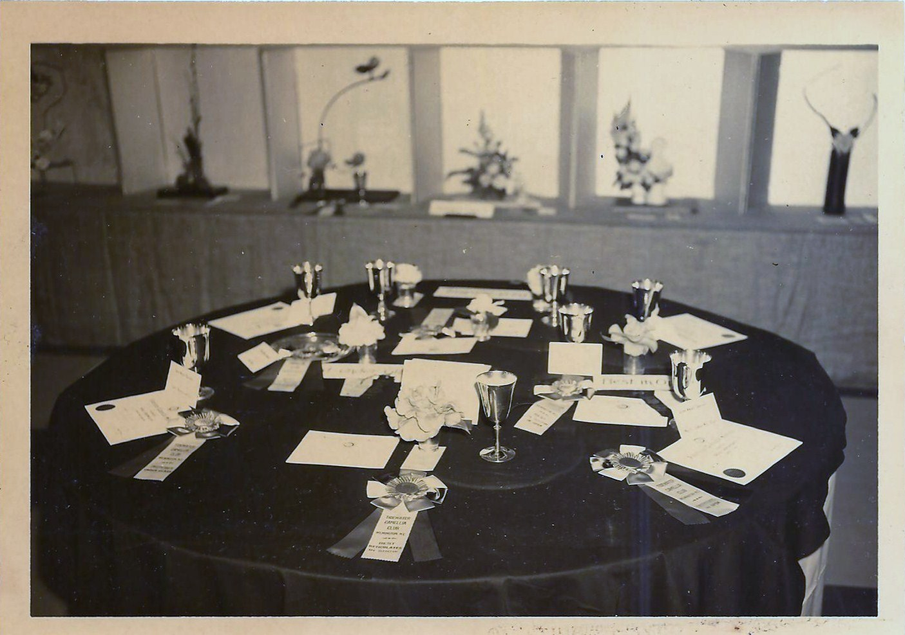
Camellia Show Awards
Camellia Show awards were traditionally goblets, bowls or serving pieces made of Sterling Silver. This view of the 1966 Court of Honor table shows Sterling Silver Goblets.

Slide 19
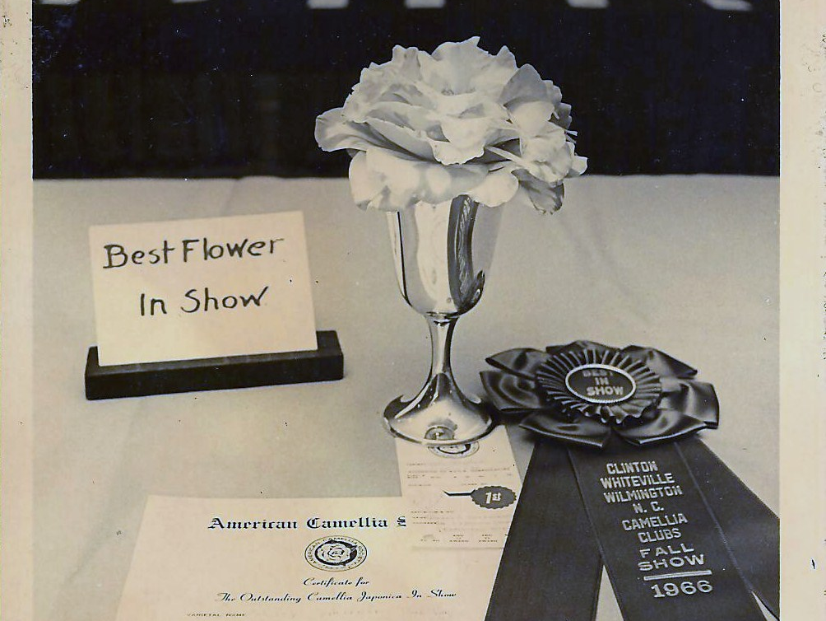
1966 Fall Show
In November 1966, the first Fall Show was sponsored by the Coharie Men’s Garden Club of Clinton, NC. The Whiteville Camellia Society and the Tidewater Camellia Club had demonstrations on grafting and air layering.

Slide 20
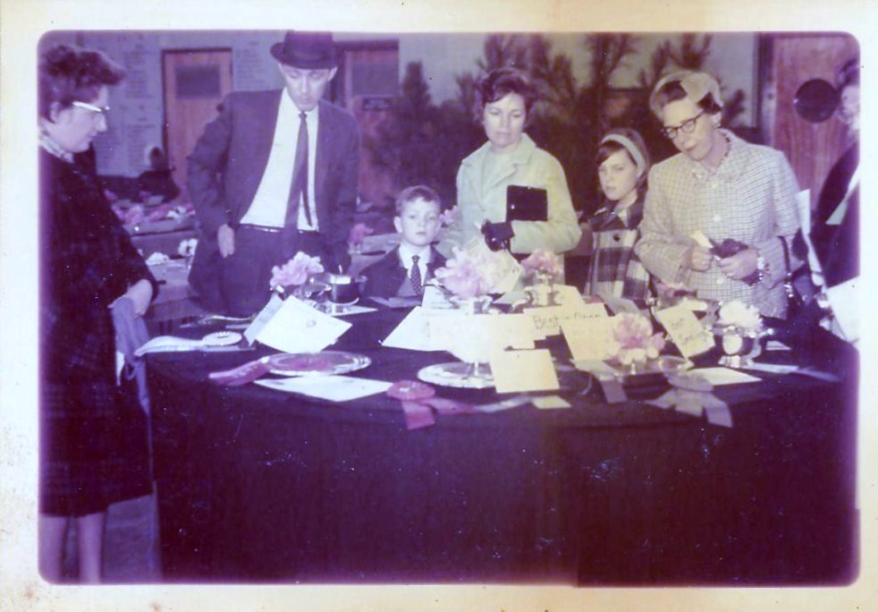
1968 Camellia Show
The 1968 show was held at the National Guard Armory on Carolina Beach Road. During the 60’s & 70’s, judges were treated Friday nights to heavy hors d’oeuvres, a luncheon on Saturday and a banquet on Sunday. The Friday night event was usually held at Les Marbury’s and later at Henry Rehder’s home.

Slide 21
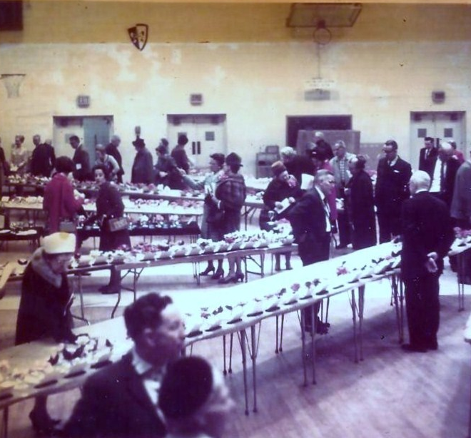
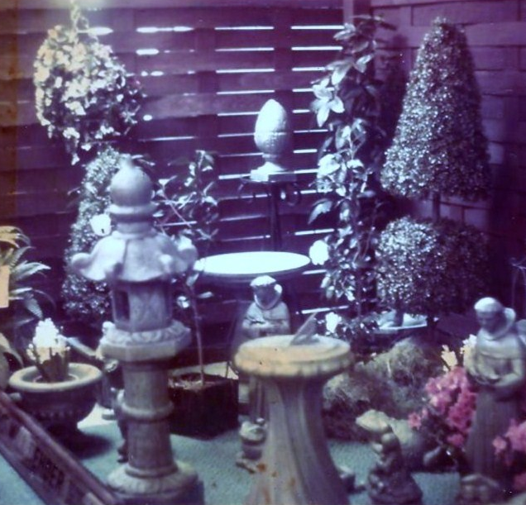
1969 Camellia Show
The 1969 show was held at Roland Grise Jr. High School. The gym floor had to be covered with heavy paper to protect the floor from damage by people walking on it. The Roland lunch room was used for a nursery show. Nurserymen from south eastern North Carolina exhibited their plants in competition with one another.

Slide 22
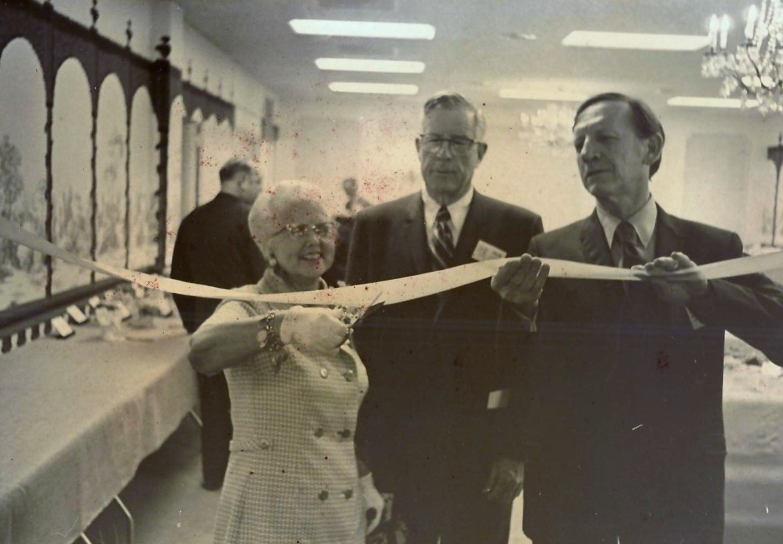
1970 Tidewater Club Membership Change
In the early 70’s, a meeting was held at Plantation Gardens on Metts Ave. A proposal was made and adopted to allow women in the club.

Slide 23
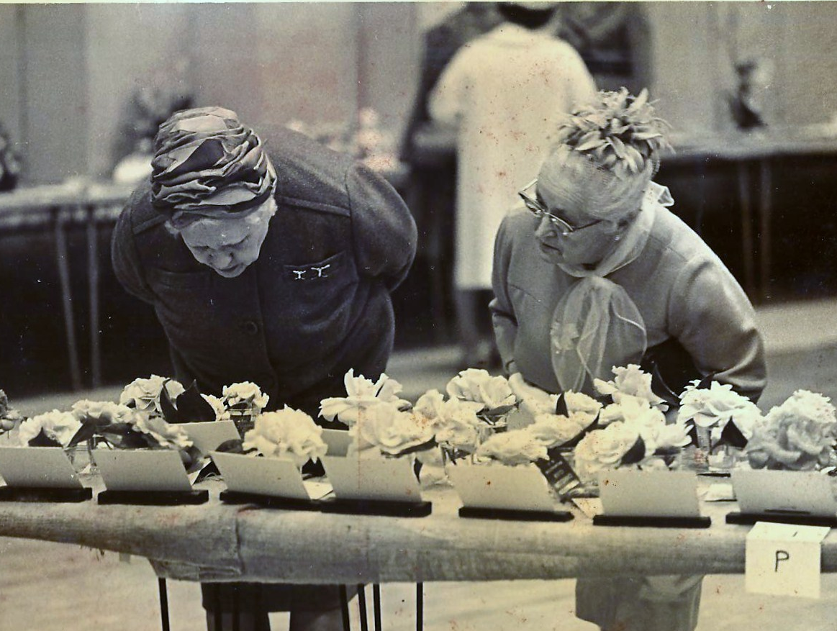
1970 Camellia Show
1970 was the last show held at Roland Grice Jr. High School.
There were 2500 blooms on display.

Slide 24
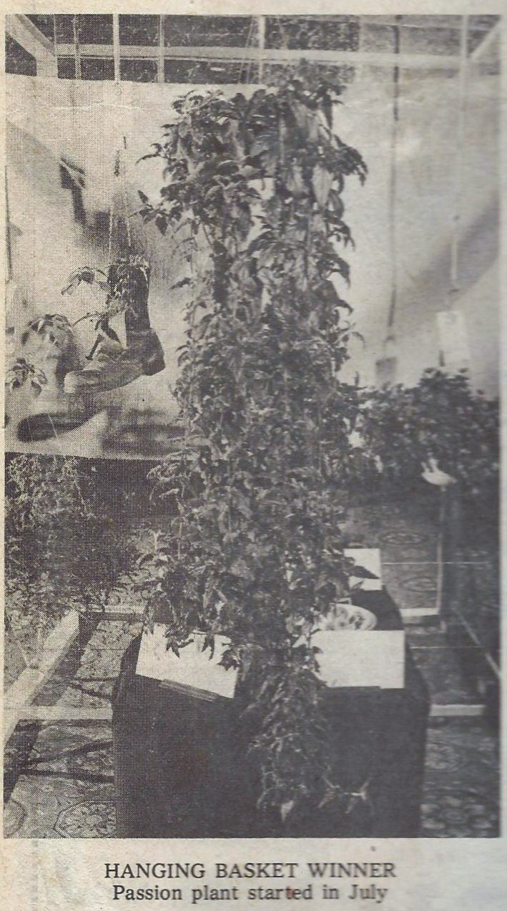
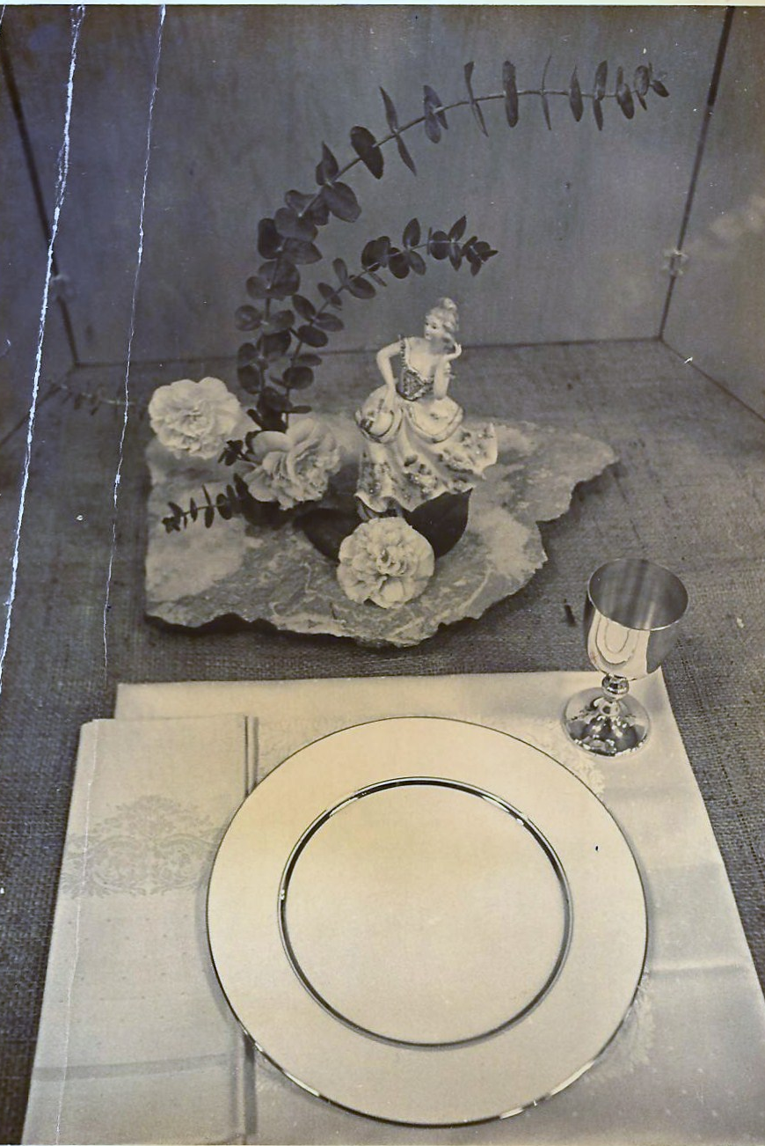
1975 Special Show Displays
The 1975 show was held at the Hilton. Over 1300 blooms, 140 hanging baskets and 50 arrangements were displayed. Table settings featuring camellias was a popular display.

Slide 25
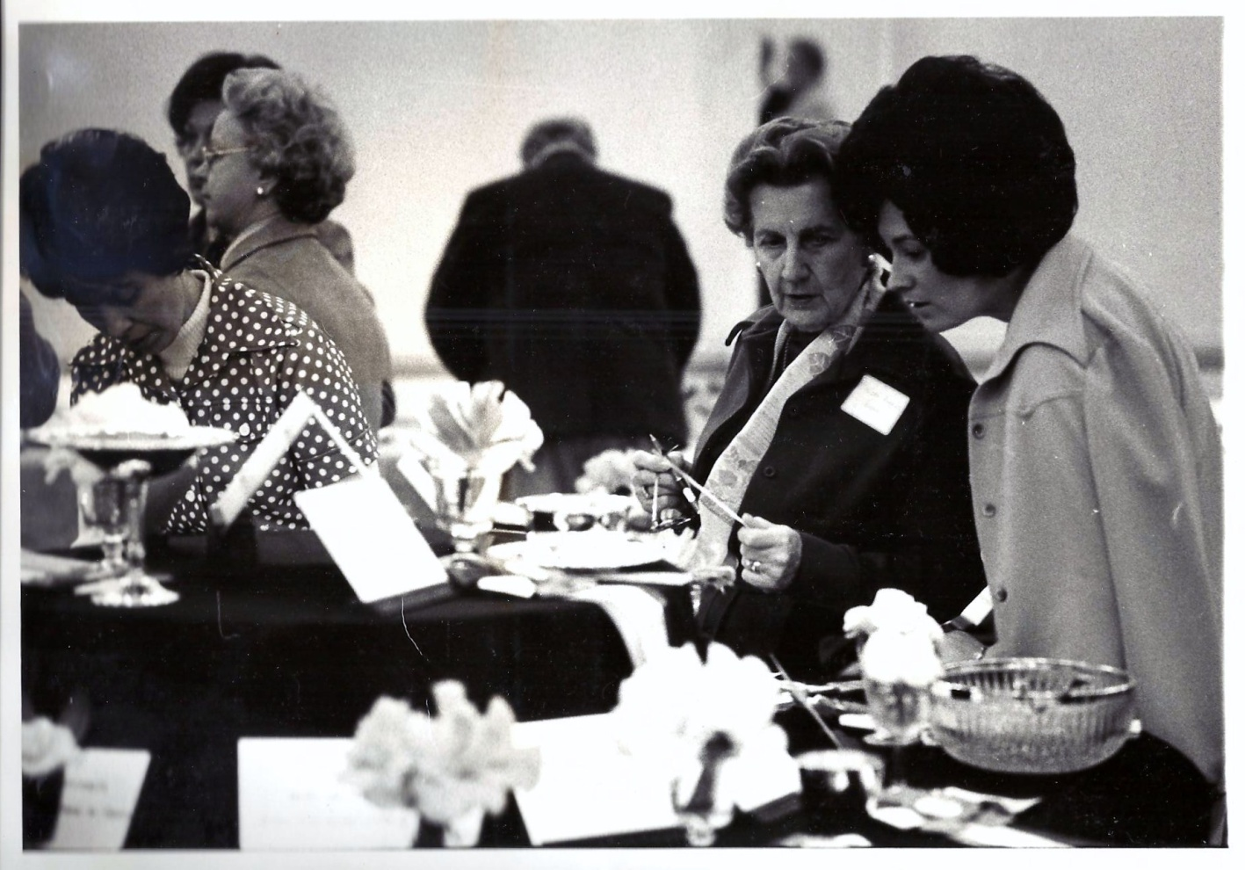
1977 Camellia Show
1976 -1978 shows were held at the Blockade Runner Hotel. Early shows were funded by members and local merchants. Later corporate sponsors provided the funds through sponsorships to put on the shows.

Slide 26
1977 Show Sponsors
Andrews Mortuary
L.R. Armstrong & Son
Baldwin-DesChamps
Balentines
Blockade Runner
Browning Photography
Burke Yapp Funeral Home
Cape Fear Ford
Carolina Savings & Loan
Causey Garden Center
Coca-Cola Bottling Works
Cross Seed Company
Farmers Supply
Federal Paper Board
James Ferger, Landscape
First Citizens Bank
First Union National Bank
Fleishman’s
Flipp’s BBQ
Foy, Roe Company
Freeman Shoe
Furniture City
Garden Inn Restaurant
Godwin Oil
Reagan Construction
Tom Reich Chevrolet
Ripa Industries
Rippy Cadillac Oldsmobile
S & G Concrete
Sears, Roebuck & Co.
Sophie Flowers Florist
Springer Coal & Oil
Star-News
Sutton Council
Swift Agriculture Chemicals
Planters National Bank
Walker Taylor Insurance
Tinga Nursery
USS Agri-Chemicals
Vaughn & Company
Wachovia Bank
Ward Funeral Home
Will Rehder Florist
Wilmington Electrical Supply
Wilmington Fertilizer
The Wonder Shop
Woody’s Greenhouses
Woolco
Good Earth Barn
Graves Electric
Graystone Galleries
Gurr Jewelers
Hanover Iron Works
Harris Pontiac
Glasgow Hicks Insurance
J. M. Fields
Joe’s Nursery
Kingoff’s Jewelers
Kmart
Gold N Crust Spaghetti House
LaMode, Inc.
Lancaster’s Picture Frame
Lincoln Construction
Lowrimore, Warwick & Co
MacMillan Buick
Harris Newber, Agent
Pearsall & Company
J. C. Penny
Pepsi-Cola Bottling Corp.
The Plant Place
Queensboro Steel Corp.
The Raw Bar

Slide 27
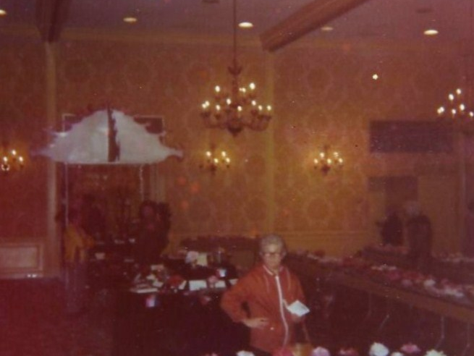
1979 Camellia Show
The 1979 & 1980 shows moved to the Wilmington Motor Inn. Burlap was no longer available from the burlap company. Lewis Strawberry Nursery provide black plastic to cover the tables for many years.

Slide 28
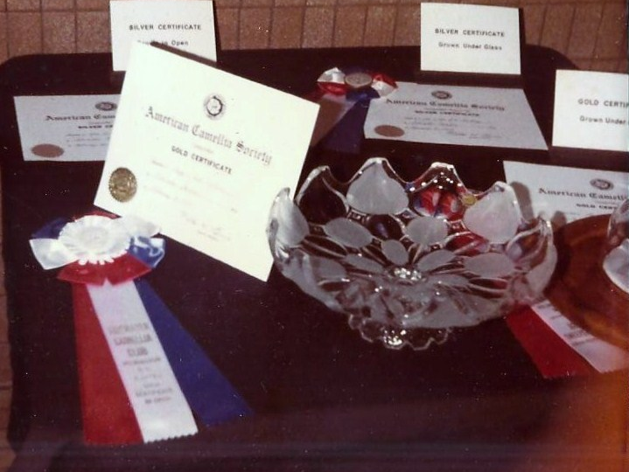
1980s Camellia Shows
In 1980 the show was moved to Independence Mall and the mall provided security for the beautiful lead glass trophies. In 1980 there were 1300 blooms on display.

Slide 29
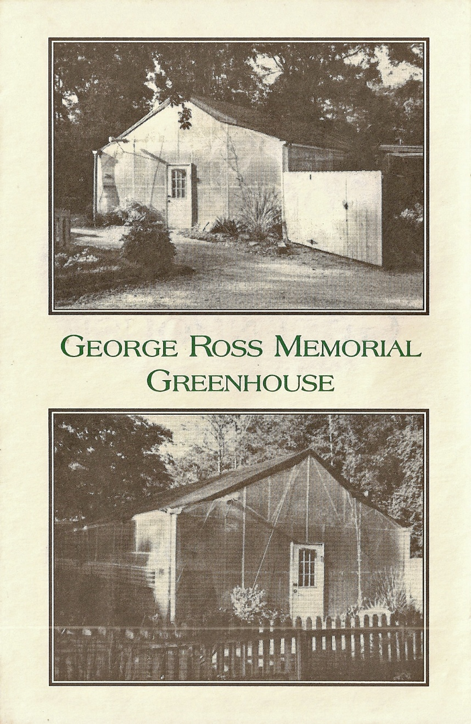
1990 New Hanover County Arboretum Donation
During the early 1990s, Tidewater members and friends gathered to sponsor the building of a greenhouse at the NHC Arboretum to honor long time Tidewater member George Ross. The greenhouse is still in use today.

Slide 30
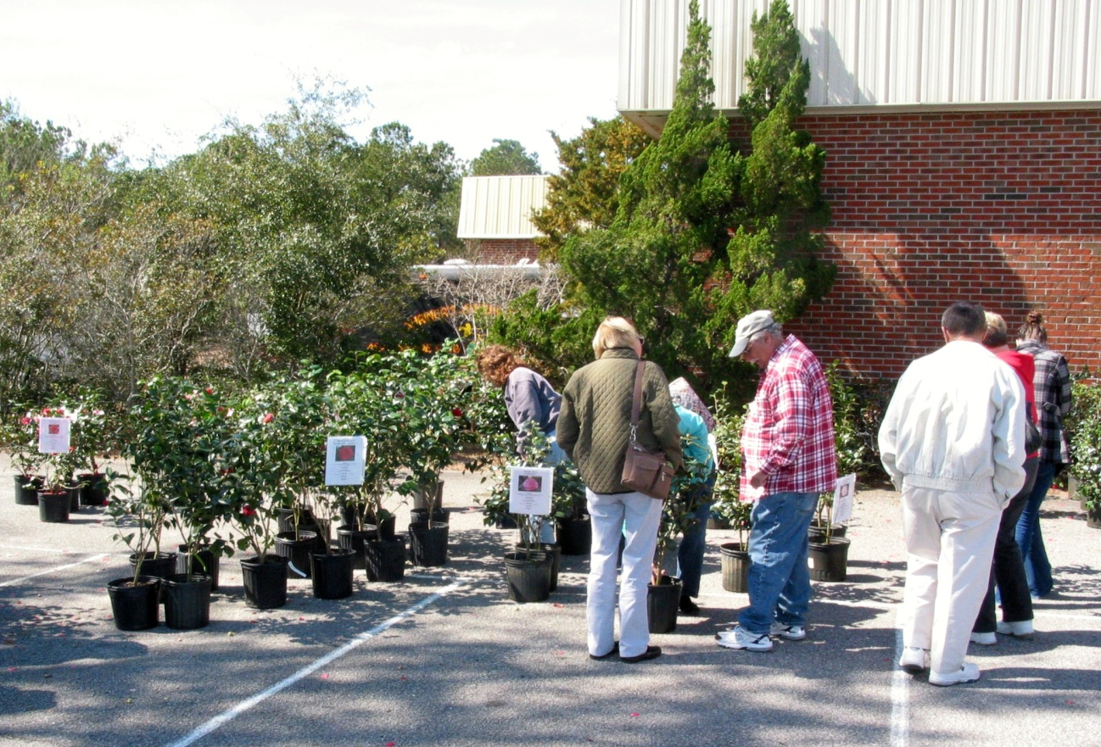
Camellia Plant Sales
Tidewater began to sell camellia plants to fund its shows beginning in 2000. Their plant sales have been a show highlight ever since. In 2002, Independence mall no longer wanted to host the show so the show was moved to Masonic Lodge on South 17th Street.

Slide 31
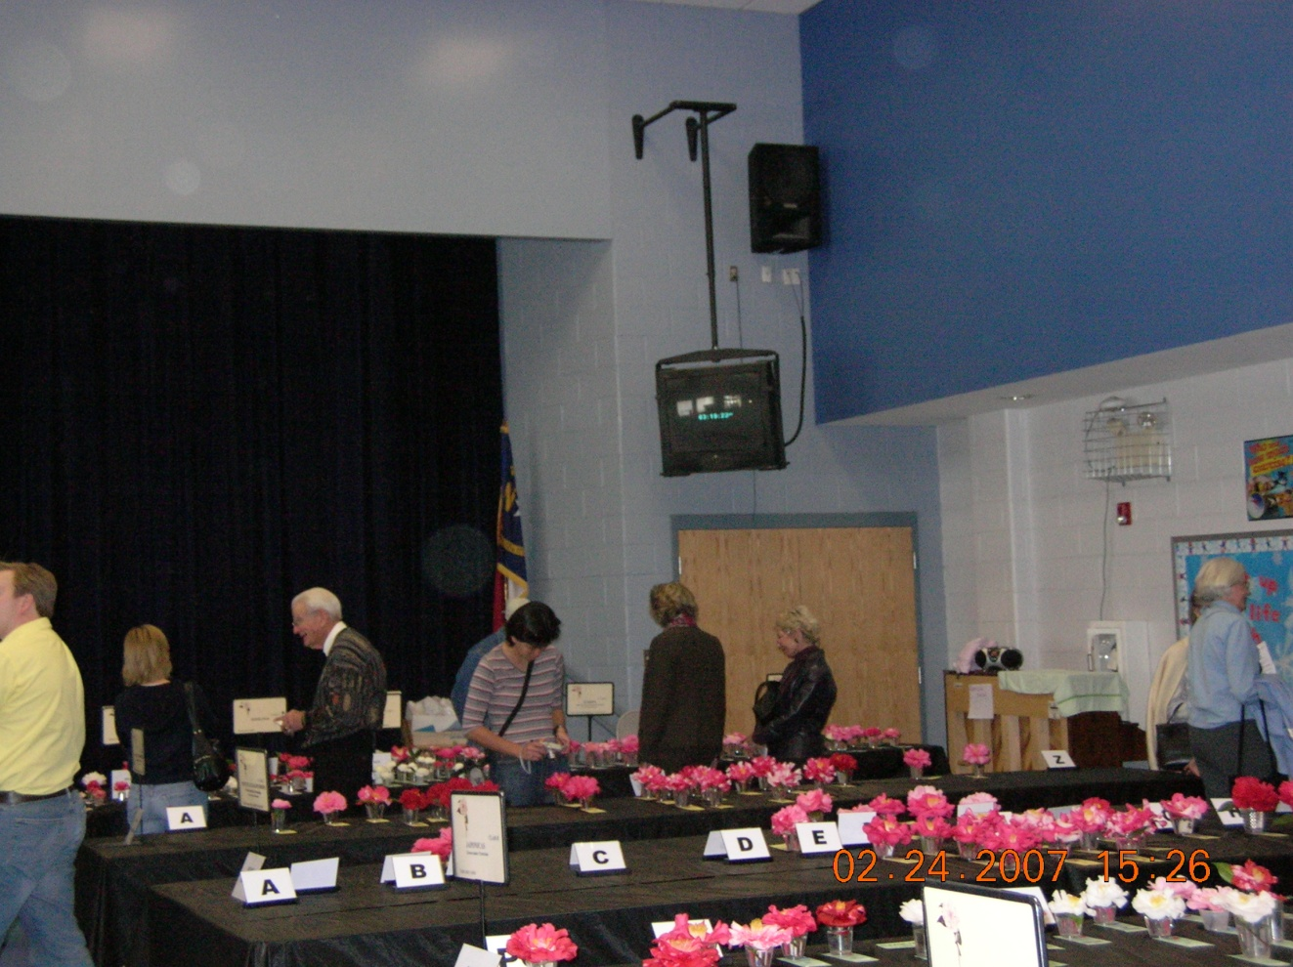
2007 Camellia Show
Bill Howell
In 2006 the show was held at Parsley Elementary School on Masonboro Loop Road. Parsley was a favorite location for the show but the show was again moved in 2009 due to prohibitive costs.

Slide 32
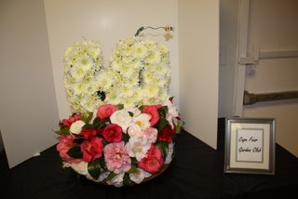
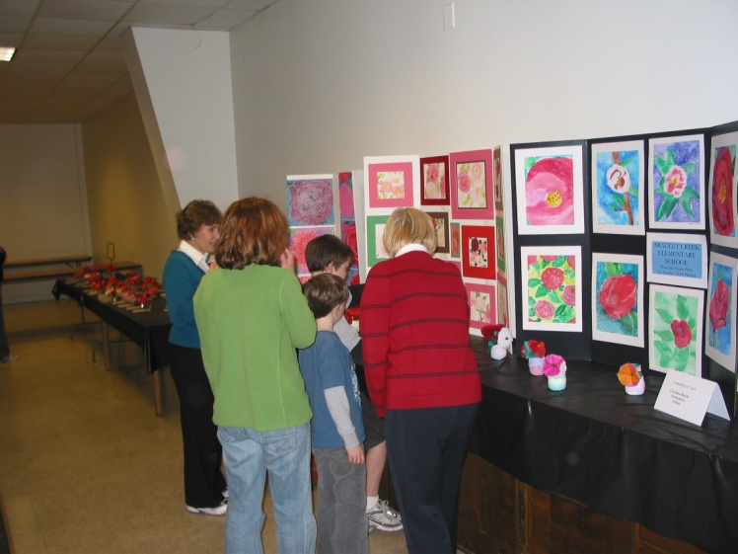
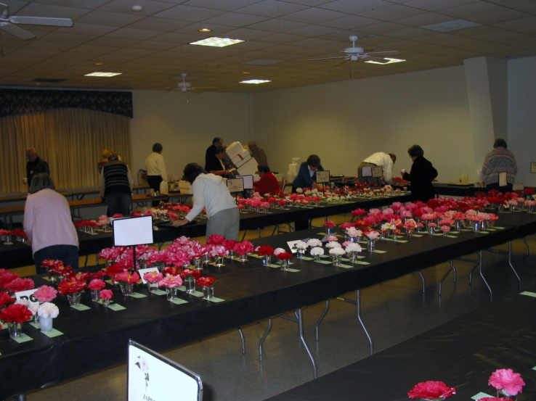
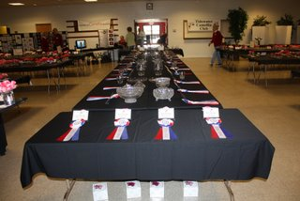
2010 Camellia Show
In 2010, the show was held at the Shrine Club on South College Road. 1080 blooms were displayed. Floral arrangements, Camellia Art from local schools and Tidewater’s now famous camellia plant sale were featured at the show and continue today.

Slide 33
2012 New Logo
Tidewater Camellia Club commissioned a club Logo for its publicity and club attire.

Slide 34
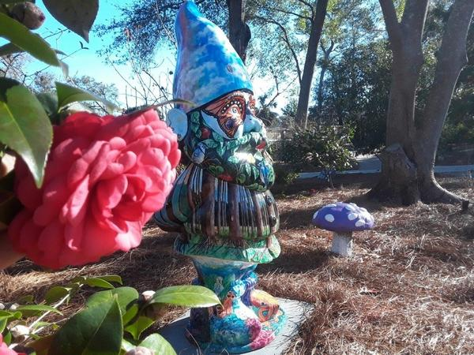
New Hanover County Arboretum Camellia Garden
In partnership with the Cape Fear Garden Club, Tidewater began developing a featured camellia walk in 2013. Camellias were installed in 3 phases and today include over 175 plants.

Slide 35
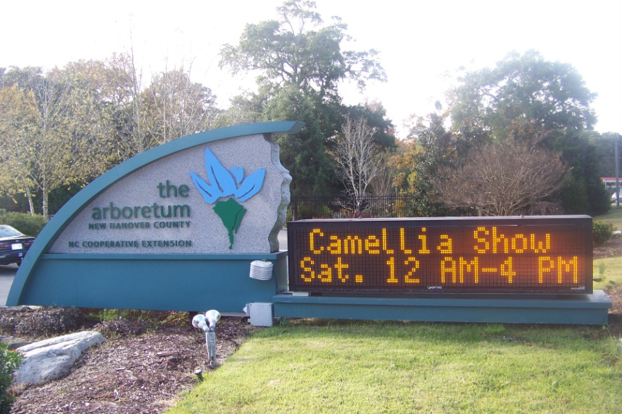
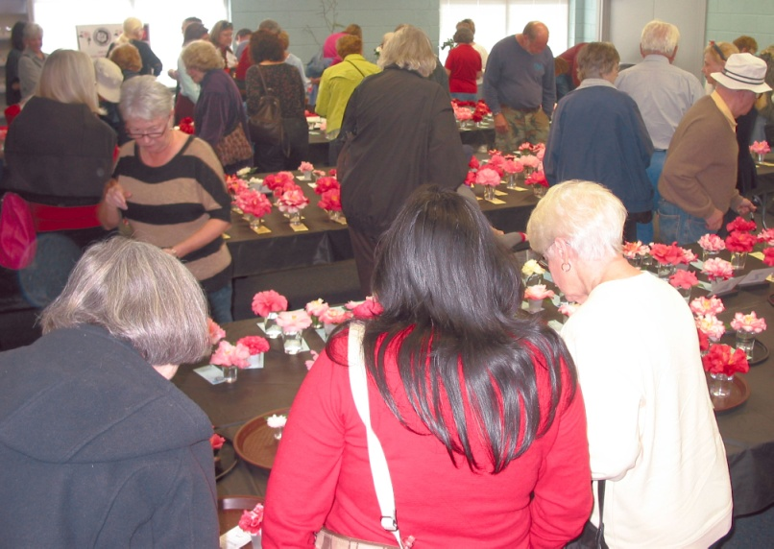
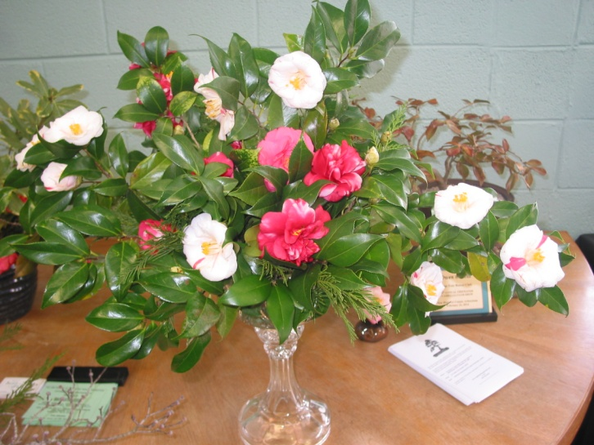
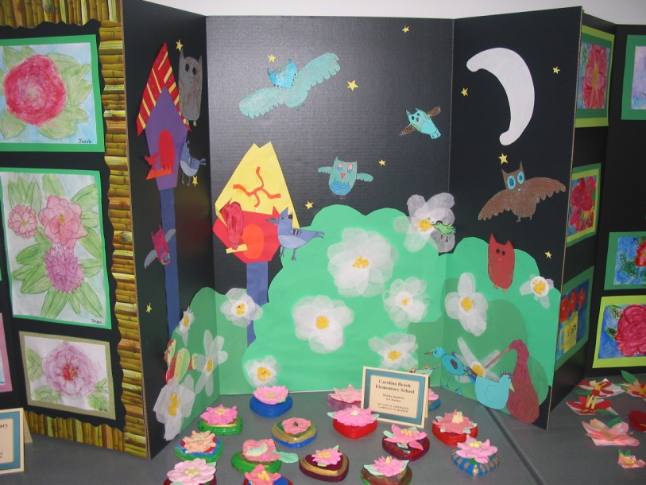
2014 Camellia Show
The 2014 show was moved to the New Hanover County Arboretum and continues at this location today. Attendance and public support for the new location soared. Camellia care workshops for the public were added.

Slide 36
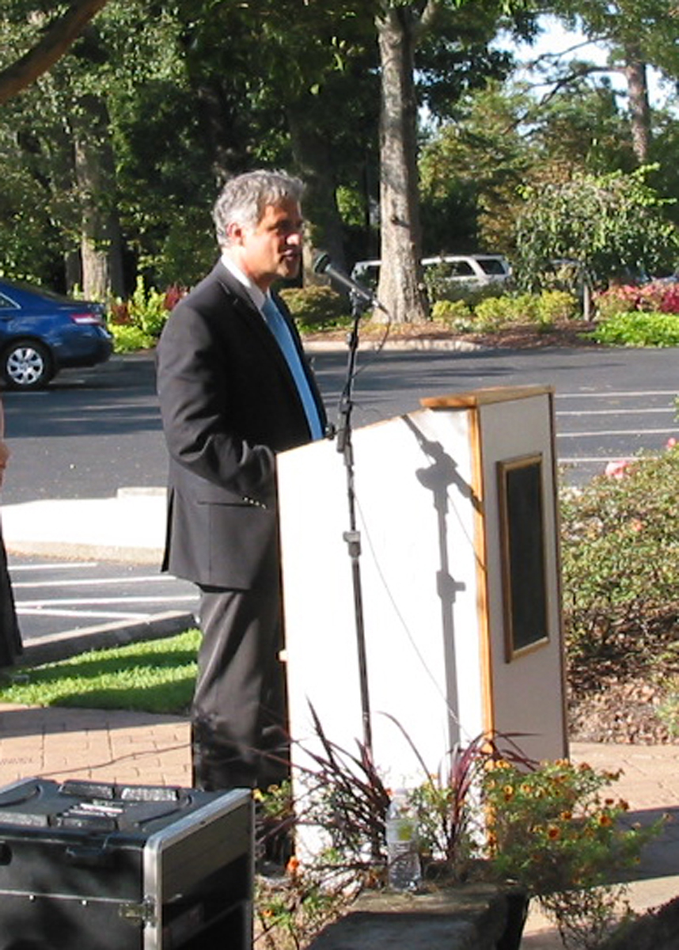
Camellia City 2014 Proclamation
October 2014 Tidewater Camellia Club celebrated the proclamation of Wilmington North Carolina becoming a Camellia City by Mayor Saffo

Slide 37
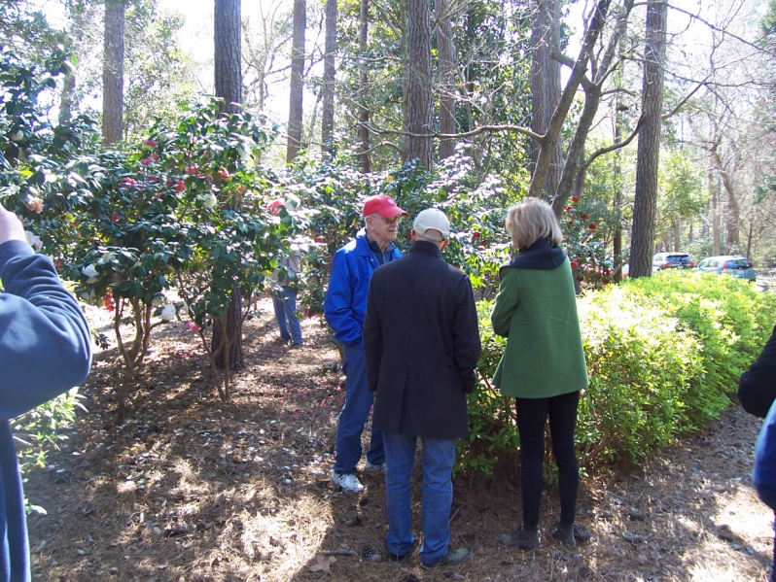
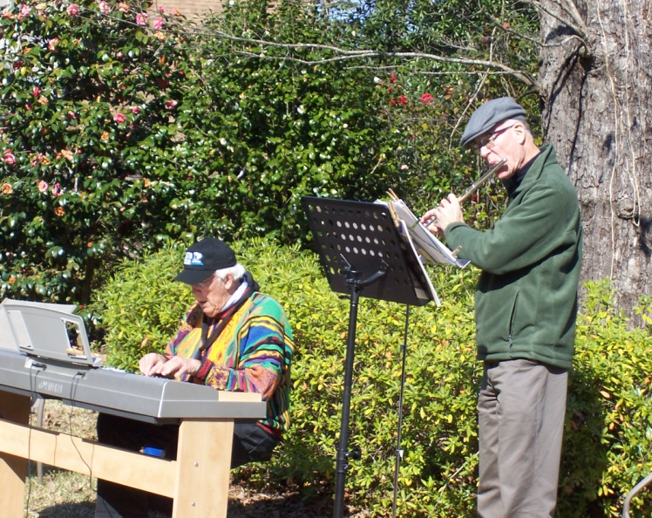
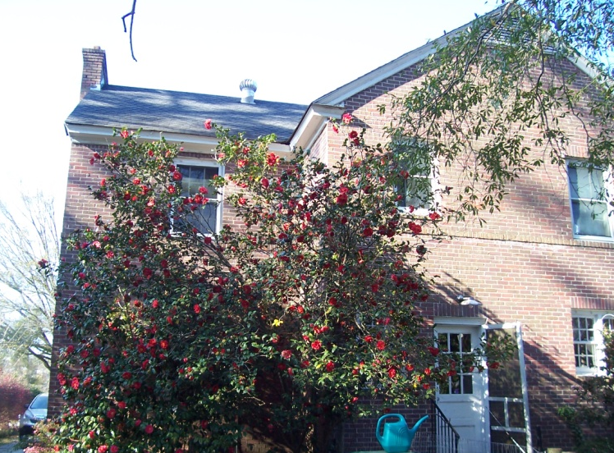
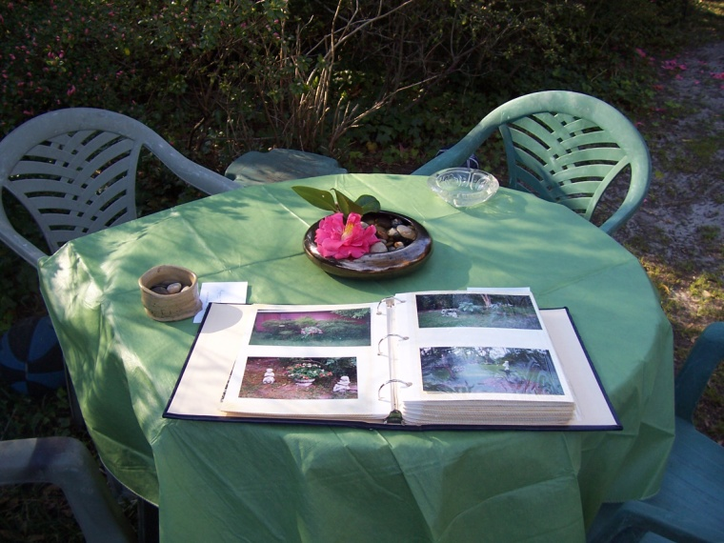
2017 Garden Tour
In 2017 Tidewater held its first Members Garden tour. Tours of 5 Member gardens were enjoyed by the full membership.

Slide 38
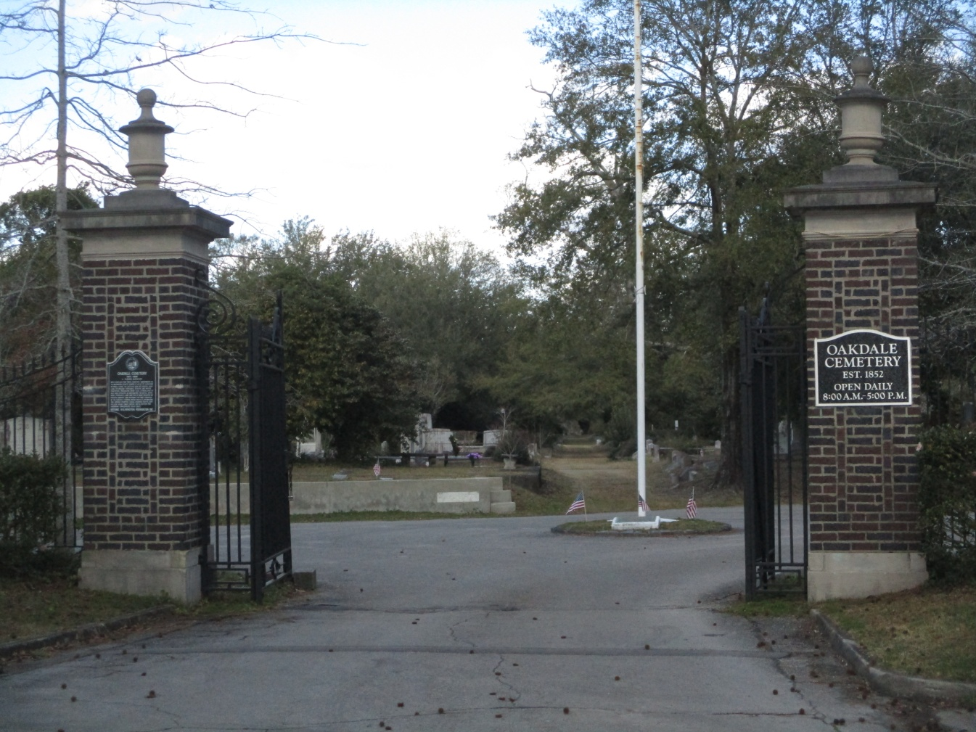
2019 Oakdale Cemetery
Tidewater is active in the Wilmington community with service projects that promote camellias in public areas. In addition to its support of the Arboretum camellia garden, Tidewater has supported camellia collections at UNCW, Lower Cape Fear Lifecare Hospice, The Carousel Center and the historic Oakdale Cemetery.

Slide 39
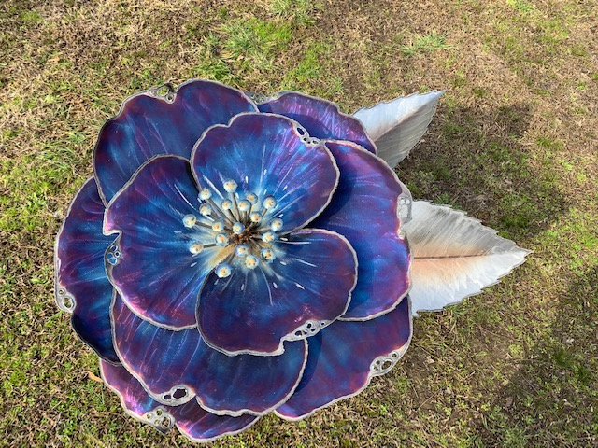
2020 Camellia Show
Tidewater Camellia Club celebrated its 70th Annual Show with a commissioned art sculpture for the New Hanover County Arboretum. The sculpture was dedicated at the beginning of the show.

Slide 40
2020 New Hanover Arboretum Honor
Tidewater Camellia Club sponsors the New Hanover County Arboretum becoming an official Camellia Trail Garden by the American Camellia Society.

Slide 41
2021 Tidewater Camellia Club Festival & Virtual Show
Tidewater creates a unique event with COVID safe & socially distanced Festival workshops, camellia garden tours and a virtual format for its camellia judging process and camellia show displays.

Slide 42
2021-2022 Tidewater Camellia Club… We Survived Covid!
TCC gradually returned to normal, post Covid, activities
Very successful sales and show (Nov and Feb)
First ever scholarship ($1,000) awarded to a Cape Fear Community College Horticulture student

Slide 43
2022-2023 Tidewater Camellia Club… A Banner Year
Inaugural Ed & Lou Powers Award
Numerous workshops and garden tours
Record membership growth
New and varied venues for events, activities and meetings

Slide 44
2022-2023 Tidewater Camellia Club… A Banner Year!
Magnificent TCC Reception & Banquet
Very successful sale and show…hundreds in attendance, 20 new members at Feb sale and show
Awarded 2 grants totaling $2,400 to St. Andrews on the Sound Pre K and Johnson Pre K Headstart to build raised beds for variety of plants and camellias

